Slide 1
professional privilege
outline of Polish regulations and developments
Piotr Wieczorkiewicz
attorney at law

Slide 2
What is professional privilege
“Attorney at law is under obligation to keep secret everything learnt in connection with provision of legal advice”
“Observing professional secrecy is a right and duty of attorney at law. It is a fundament of clients trust and guarantee of rights and freedoms.”

Slide 3
all information concerning the client and his matters, disclosed to the attorney at law by the client or obtained in other manner in connection with performance of any professional duties, irrespective of source of such information or form of their perpetuation;
all documents prepared by attorney at law and correspondence between attorney at law, the client and persons involved in running the case – created for purposes related to provision of legal assistance;
information disclosed to attorney in law before commencement of any professional duties if, judging by the circumstances, such disclosure was made for the purpose of provision of legal assistance and was justified by expectation, that the attorney at law shall provide that assistance.

Slide 4
Is there a time limit
“Professional secrecy may not be limited in time.”

Slide 5
Waiver by client
Under Polish law there are no provisions permitting waiver of professional secrecy by the client.

Slide 6
criminal proceedings general rules
“common” secrecy – right to refuse answering any questions which relate to issues covered by professional secrecy, with possible exceptions;
secrecy associated with defence in criminal proceedings – absolute; attorney can not be questioned;

Slide 7
EXCEPTION 1 waiver by the court
Attorney at law can be questioned in criminal proceedings, only subject to fulfilment of all following conditions:
it is „necessary for the justice system”; and
the given fact may not be established in any other way, and
professional secrecy is specifically waived by decision of criminal court.

Slide 8
EXCEPTION 2 “fruits of the poisonous tree”
In 2016 a 180 degrees turn:
from: “It is not acceptable to conduct and use evidence obtained for the purpose of criminal proceedings through criminal offence.”,
to: “Evidence may not be considered unacceptable solely based on the fact that it has been obtained with infringement of procedural provisions or by criminal act, unless such evidence has been obtained in connection with public duties by a public officer, by: manslaughter, deliberate damage to health or depravation of freedom.”

Slide 9
EXCEPTION 3 “self defence”
The law is silent on use of information covered by professional secrecy in own criminal or disciplinary proceedings.
A widely accepted view however is that in this conflict of values between professional obligations and right to defence – the latter prevails.
Large risk of misuse by initiating procedures just to extract information.

Slide 10
civil proceedings
attorney may refuse to answer any question, if the testimony would result in breach of material professional secrecy
no exceptions or waiver possibilities
no provisions however regarding documentation, transmissions or regulating illegal or unacceptable evidence

Slide 11
EXCEPTION 4 money laundering and financing terrorism
A new law on counteracting money laundering and financing terrorism in 2018.
Many obligations have been imposed on attorneys at law, including introduction of client verification procedures, establishing ultimate beneficiaries of certain transactions etc.
The law provided direct statutory waiver of professional secrecy in respect to selected issues.

Slide 12
EXCEPTION 4 money laundering and financing terrorism
obligation to “immediately” report in the case of “justified suspicion, that given transaction or given values may have connection with money laundering or financing terrorism”
own assessment must be made;
obligation not to inform the client or anyone else;
administrative penalties, including a fine up to amount exceeding PLN 20.000.000 for failure to report.

Slide 13
EXCEPTION 5 tax schemes (MDR)
We are required to learn what tax schemes are and how to recognize them, which may not be so simple for lawyers nor dealing with tax issues on a daily basis (100 pages guidebook on MDR reporting issued by Minister of Finance);
We are required to provide information to the client, that the structure or transaction falls under description of a tax scheme (either standard or custom made);
We are accountable not only for what we recognized but also for we should have recognized;
We are under obligation to disclose all schemes, regardless of their legality;
The law provides that we make full notification when confidentiality is waived by the client, otherwise, we report only the scheme, on a no-name basis. Since however, the tax authorities have access to our invoices, tracing the clients is not a difficult task.

Slide 15
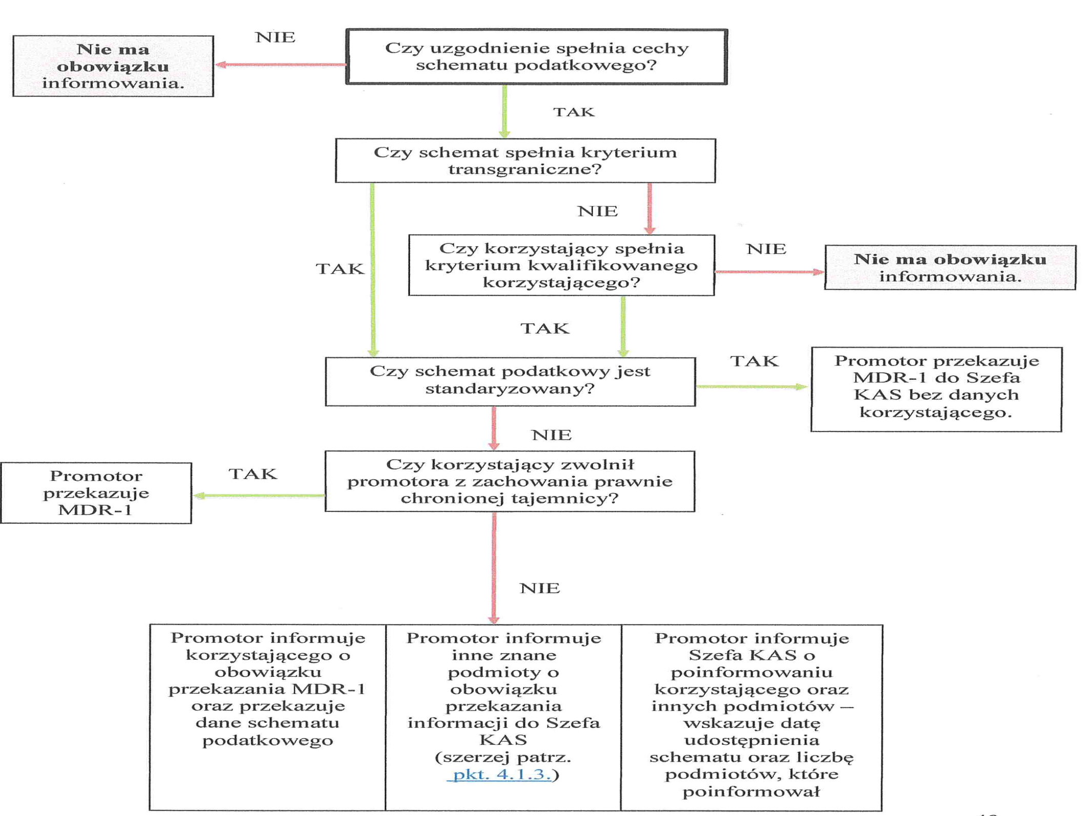

Slide 17
conclusions
In Poland we seem to have very strong fundamental regulations concerning professional secrecy.
Some issues could use clarification or direct regulations, such as civil procedure in respect to confidential documentation, transmissions or generally regulating unacceptable evidence and disclosures in own cases.
There is a tendency to gradually weaken our professional secrecy, each time moving further and crossing new limits.
First limit crossed – waiver in criminal proceedings - individual court decision, narrow criteria and possibility to appeal.
Second limit crossed – acceptance of “fruits from the poisonous tree” – still subject to individual decision of the court, but extremely dangerous in any democratic society.
Third limit crossed – reporting suspicion of money laundering or financing terrorism – for the first time applying to all attorneys and requiring active reporting without any individual requests from the justice system, also for the first time, without informing the client.
Fourth limit crossed – tax schemes reporting – in addition to applying to all attorneys and requiring active reporting without any individual requests, for the first time reporting concerns matters, which are not necessarily illegal.

