Slide 1
Independence of Bar Tokyo Bar Association
For World City Bar Leaders
September 2019
Haruhiko Esaka / esaka-h@toben.or.jp
Vice President

Slide 2
Outline of Agenda
History – Before and After WWII
What is “Independence”? Why is it important?
Who is our supervisor?
Our effort - financial independence, no governmental appointments, and disciplinary procedures
Conclusion

Slide 3
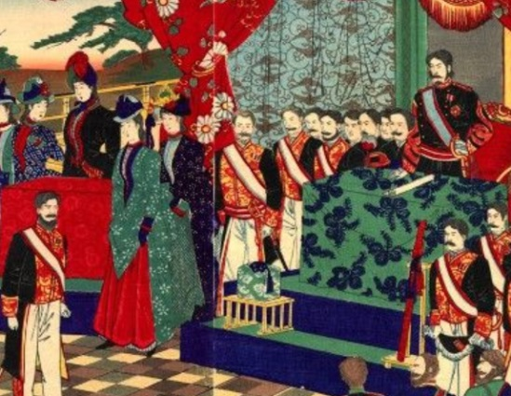
History
Before WWII – Era supervised by Gov.
Act of Attorney 1893: gave attorneys legal ground.
German style – supervised by Chief Prosecutors of each district court.
Amended 1933: Ministry of Justice authorized for punishment.

Slide 4
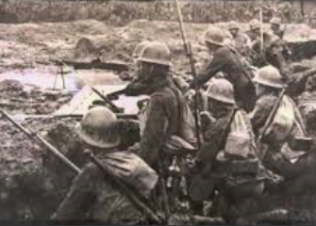
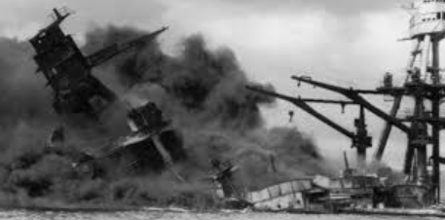
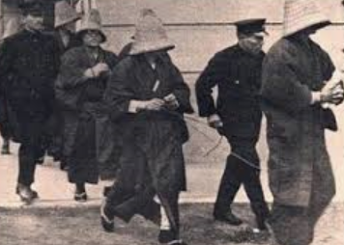
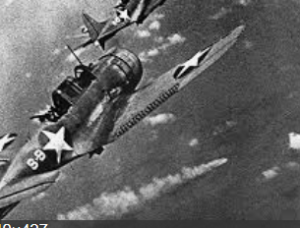
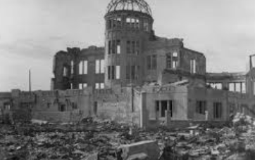
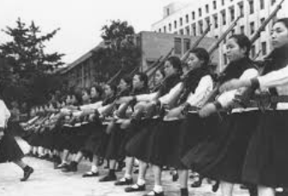
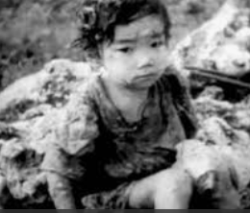
Militarism oppressed activities of bars and attorneys - Infamous “Maintenance of the Public Order Act 1924” even allowed arrest of attorneys. Gov. deprived of their qualifications!

Slide 5
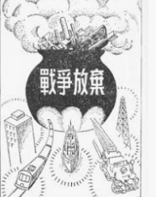
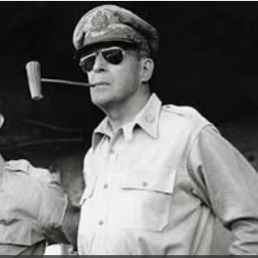
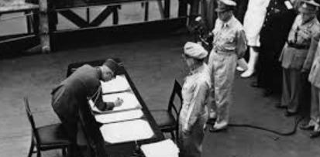
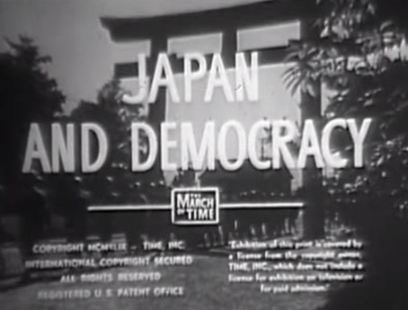
History
After WWII – “Revolution”under GHQ occupation (1945 – 1952).
Ministry of Justice vs. bars.
Bars appealed to the Parliament.
New Act 1949: Bar’s independence was established. This is the current base of status.

Slide 6
The New Act 1949 - Sophisticated for our independence.
High level of autonomy for local bar associations (including TBA) and the federation (JFBA).
The Law realized 3 key matters, including bar’s authority of disqualifying an attorney.
Why bar’s autonomy is required?
i) To battle with Gov’s interference to human rights; ii) To maintain quality of attorneys for due court proceedings; and iii) To ensure the system “Checks and Balances” among judicial institutions.

Slide 7
Bar associations have authority to supervise members.
Japanese Gov. has NO authority to supervise attorneys.
Attorneys – mandatory registration at a local bar association.
Note: Japan Federal Bar Association (JFBA) co-ordinate all local bars.

Slide 8
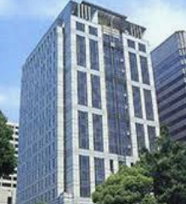
Our Effort
1. Financial Independence
– No Gov’s subsidy – A TBA member pays approx. USD 310 per month (USD 1 = JPY110) - Members must pay a high cost for independence!
2. NO Gov. appointment - President and other board members elected by registered bar members.
3. to keep members’ quality - Independence of Disciplinary/Punishment → see Next

Slide 9
Disciplinary Procedure
Claimant (Anybody can do. No filing charge)
↓ filing to TBA if “disgraceful conduct” allegation (Law Art. 56)
Discipline Committee (DC): Investigation/Hearing
→ No ground → dismissed
↓ found reasonable ground
Punishment Committee (PC) → No ground → no punishment
↓ if found “guilty”…
Sanction !

Slide 10
4 types of sanction - disciplinary punishments
Warning, ii) Suspension of Business (max. 2 years); iii) Order to Deregistration (from TBA) but not lose qualification to be an attorney; and iv) Expulsion – lose qualification to be an attorney for 3 years.
note: in the case above iii), theoretically, the member can register at another local bar to continue his business., though it is very tough in fact.
note: JFBA itself has Discipline Committee. They review the case and may change the declared sanction or even possible to reach “No sanction.”

Slide 11
Heavy burden - COST for disciplinary committee
DC has to deal any and all received cases.
Majority of payments: to investigators (such as hired attorneys)
2018 for DC and PC: approximately USD 394,000 / EURO 361,000 (EURO1 =JPY120)
Heavy Burden on TBA to defend our autonomy!

Slide 12
Conclusion
TBA has about 8,500 members (including 1,700 female members – 20%) among 41,000 members in Japan. The largest local.
As the largest in Japan, TBA have spent much of effort to defend our autonomy.
If failed, we would bring interference by Gov.,we would not be able to defend human rights.

Slide 13
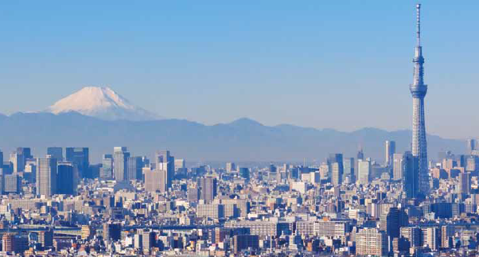
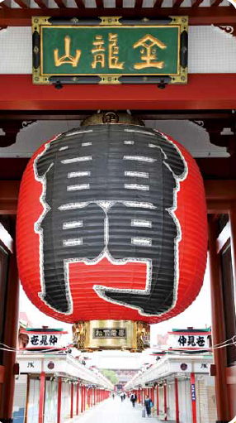
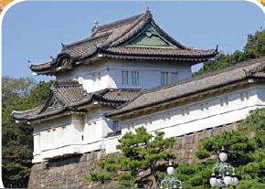
TBA will continue to effort to maintain our autonomy. Thank you for listening!
Any Questions?

