Slide 1
World City Bar Leaders
Conference in Warschau
September 11. – 14., 2019
Report of the Rechtsanwaltskammer Frankfurt
Rechtsanwalt Dr. Michael Griem
Präsident der Rechtsanwaltskammer Frankfurt am Main

Slide 2
Content
Statistical Data about Foreign Lawyers in Germany
Germany
Rechtsanwaltskammer Frankfurt am Main
Realtity beyond the statistical data
Legislation relating to European Lawyers
Legislation relating to WTO-Lawyers

Slide 3
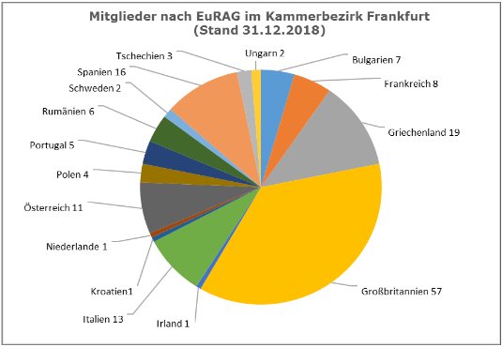
I.

Slide 4
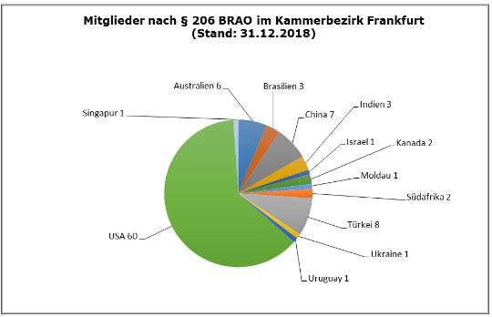
I.

Slide 5
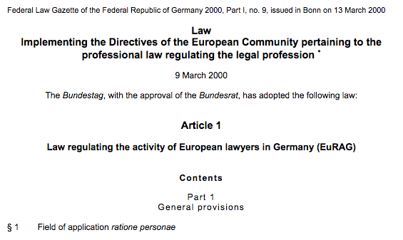
II.

Slide 6
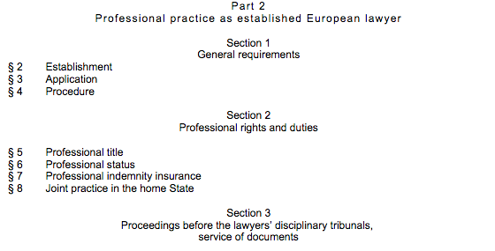
II.

Slide 7
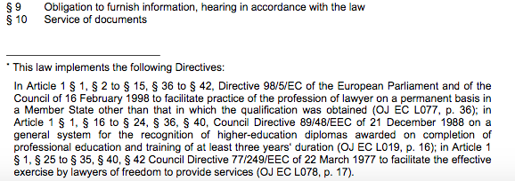
II.

Slide 8
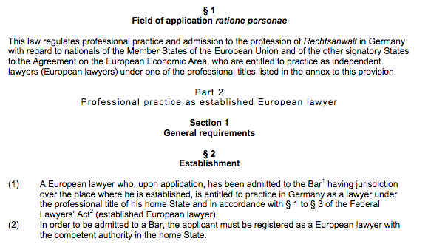
II.

Slide 9
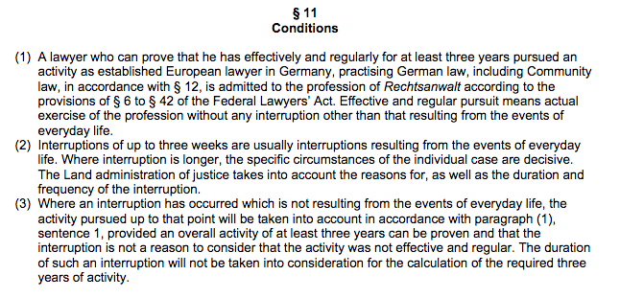
II.

Slide 10
II.

Slide 11
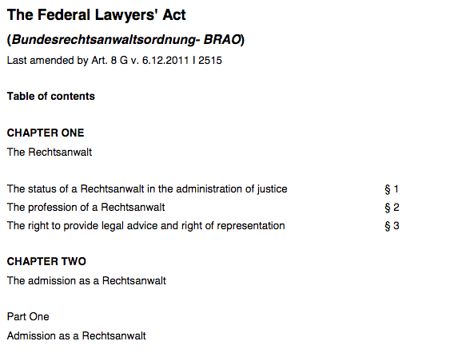
III.

Slide 12
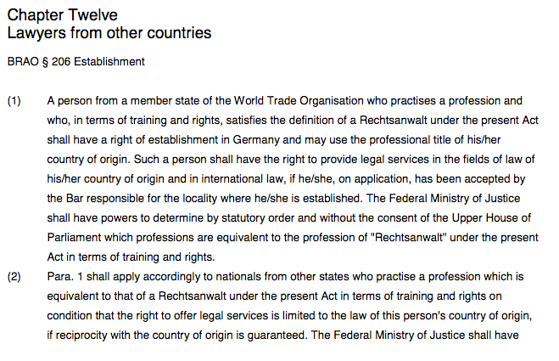
III.

Slide 13
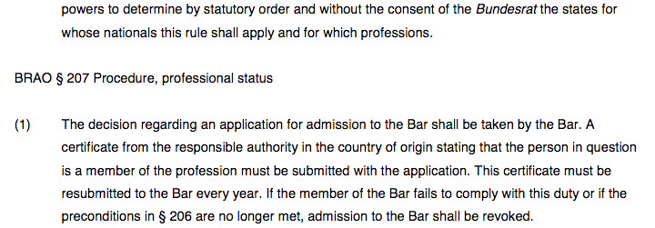
III.

Slide 14
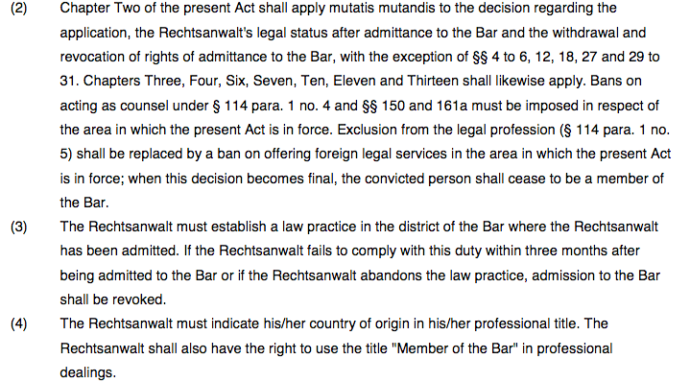
III.

Slide 15
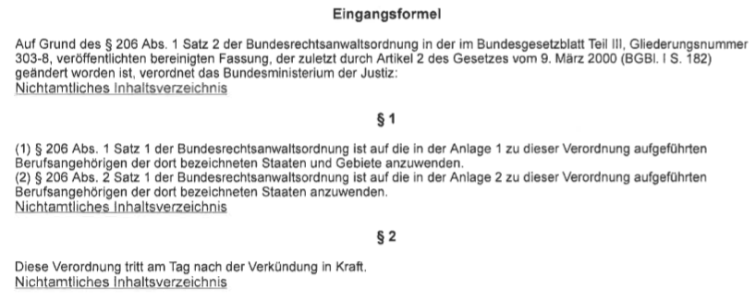
III.
Verordnung zur Durchführung des § 206 der Bundesrechtsanwaltsordnung

Slide 16
III.

Slide 17
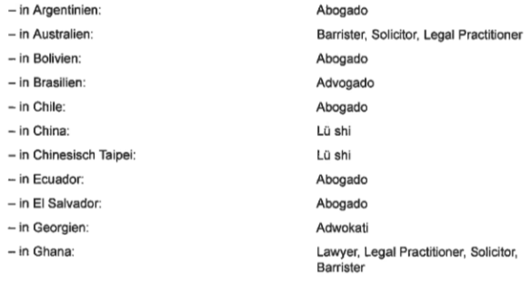
III.

Slide 18
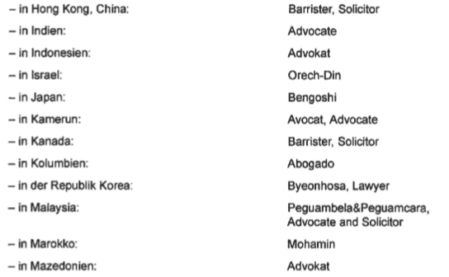
III.

Slide 19
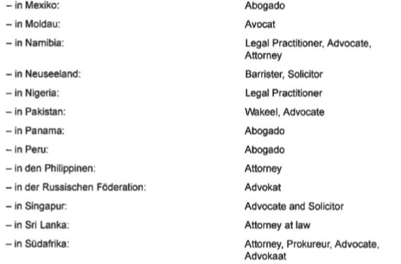
III.

Slide 20
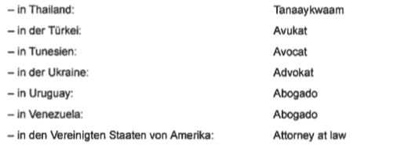
III.

Slide 21
Thank your for your attention!

