Slide 2
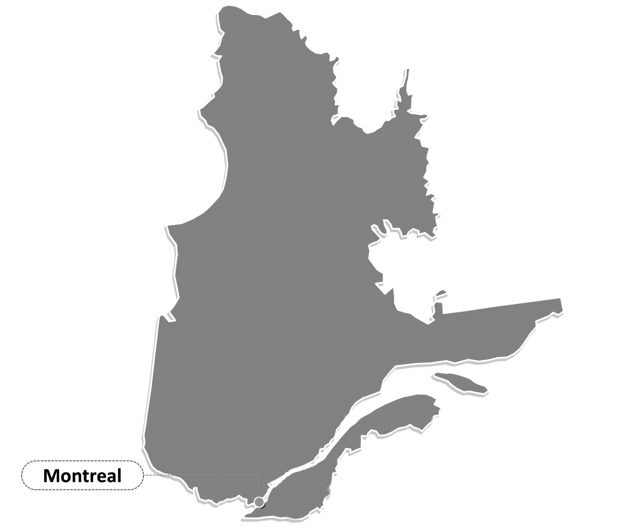
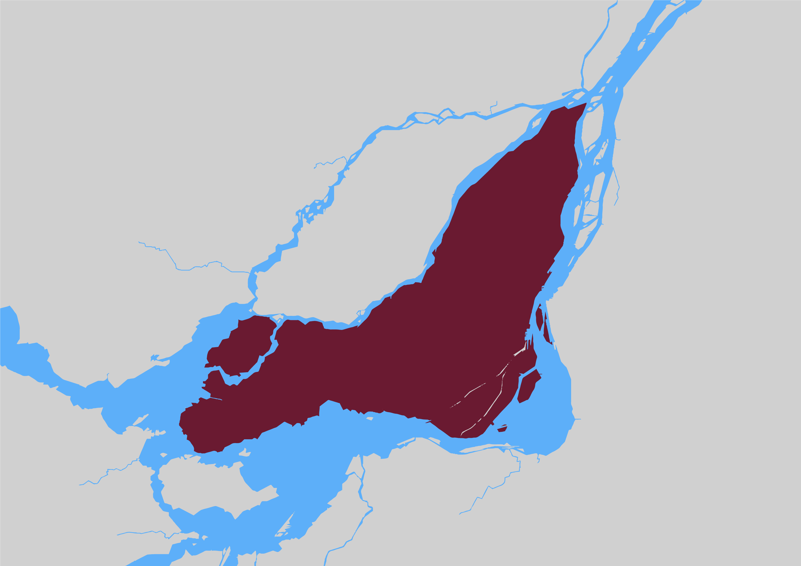
Bar of Montreal
Founded in 1849;
Largest of the Barreau du Québec’s (law society) 15 sections;
QUEBEC
MONTREAL

Slide 3
Mandatory Membership
15 000 members (barristers and solicitors) entitled to practice law in Quebec of which 52% are women;
Steeped in the civil law tradition (private law) with a common law influence (public law);

Slide 4
Governance
Managed by a council of 13 members (of which at least 4 must be English-speaking) and led by Batonnier elected for a one year term;
40 active committees with 400 members covering diverse areas of practice e.g. (corporate counsel, Bar and Bench liaison committees, women in the profession, etc.);

Slide 5
Mission
Ensure the protection of the public while supporting lawyers in the practice of law;
Salon VISEZ DROIT: annual public legal fair;
Legal Referral Service: $60 for 60 minutes;
Prosecution of the illegal practice of the law;

Slide 6
Challenges
Transformation in the practice of the law;
Access to justice;
Mental health issues in the legal profession;

Slide 7
www.barreaudemontreal.qc.ca
Thank you ! Merci !

