Slide 1
Amsterdam Bar Association:
What's happening these days?
Evert Jan Henrichs
President ("Deken") Amsterdam Bar Association
September 11, 2019
Notes:
Let me start by saying it is a privilege to be here. I stepped into Pieter van Regteren Altena's shoes six months ago and hope to continue all the good work he has done. Also, as someone born and raised in Amsterdam, I am proud to note that Amsterdam is considered a "World City".

Slide 2
Summary
President local bar association ('deken', dean) is responsible for supervision of advocates ('advocaten')
Board of Amsterdam bar association: 10 members
Bureau of bar association: approx. 20 FTE's
Approx. 5,700 advocates in Amsterdam
Deken is supervising, but also counseling advocates (providing guidance and help,the "pastoral function")
Notes:
Let's have a look at legal framework for becoming and being an attorney ("advocaat") in The Netherlands.
The terms (patron/master) reflect the old 'Guild-system'

Slide 3
Two (new) developments in supervision
New anti-money laundering legislation (implementation of 4th Anti-Money Laundering Directive)
Financial key figures to be provided by all law firms and automated analysis thereof

Slide 4
Anti-money laundering
Fourth directive challenging in at least two respects:
Advocates/law firms must have risk based approach in place. How to actively supervise this?
Supervision itself must be risk based as well. Supervisor will have to account for manner in which supervision is carried out.

Slide 5
Anti-money laundering (cont'd)
How to supervise:
Increase awareness of new obligations by publications and education
Important part of regular 'law office visits' (10-15% of law firms are visited each year
establish types of firms with highest risk and arrange for investigation into risk based approach by Financial Unit

Slide 6
Anti-money laundering (cont'd)
Anti-money laundering (cont'd)
Anti-money laundering (cont'd)
Anti-money laundering (cont'd)
Challenging questions:
With what 'intensity' does one check a firm's risk based approach (at least: has it been adequately tailored to the firm's specific practice)
What analysis is necessary for the supervisor being able to account for risk based supervision

Slide 7
Law firms submitting financial key figures
All law firms are already under obligation to have financial accounts ready by June 30 (financial reporting mostly done per calendar year)
As of this year, approx. 50% of all law firms in the Netherlands will have to submit financial key figures on 2017 and 2018 financial account by Augustus 31 (test phase, three large bar association are excluded this year)

Slide 8
Web based; automated analysis (cont'd)
System in place now to provide the following:
Web portal to provide key figures (balance sheet items, profit and loss account items)
Automated process to analyse ('calculating rules' that deliver 'grades' in respect of various items/development, resulting in green, yellow or red 'flags'

Slide 9
Web based; automated analysis (cont'd)
Elements taken into consideration ( 'grading points'):
equity/free reserves
significant decrease in revenue and/or profit
solvability, liquidity and revenue/cost ratio's
debt (in particular unpaid fees)-turnover ratio
current account with partners/business owners

Slide 10
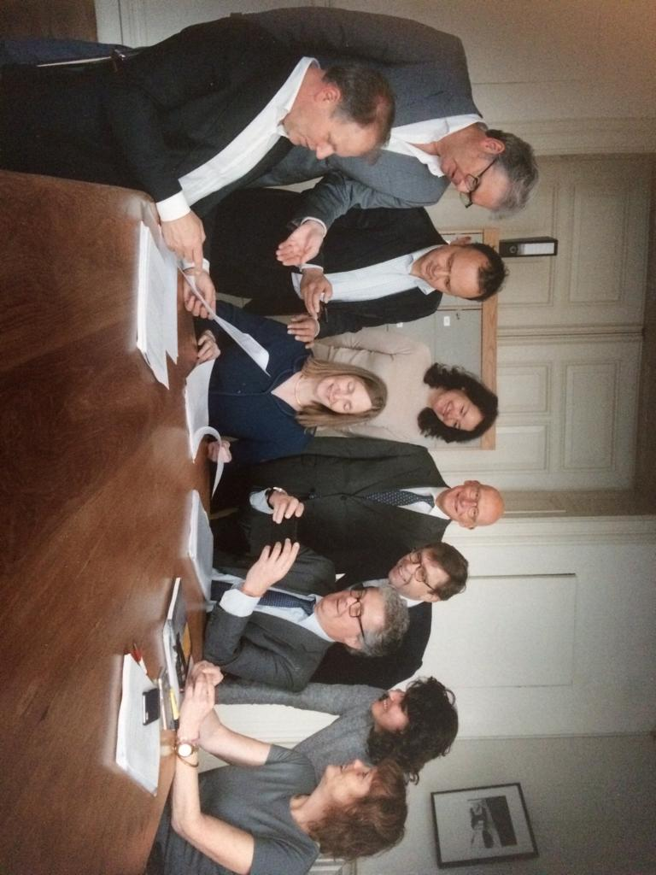
& finally: greetings from Pieter, the board . . .

Slide 11
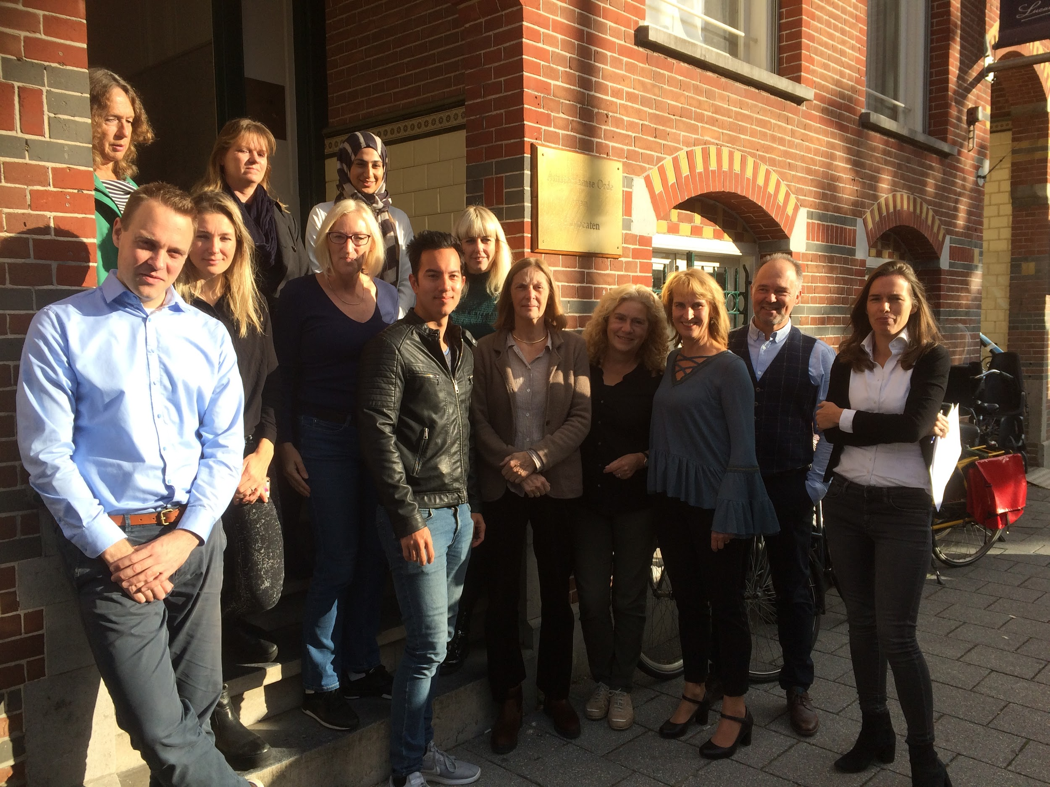
. . . and the entire team!
Notes:
Pretty picture, but come visit us and then turn around: you’ll see both the Rijksmuseum with 20 rembrandt pictures or so and rhe Van Gogh museum

